Slide 1
“All Summer in a Day”
Vocabulary

Slide 2
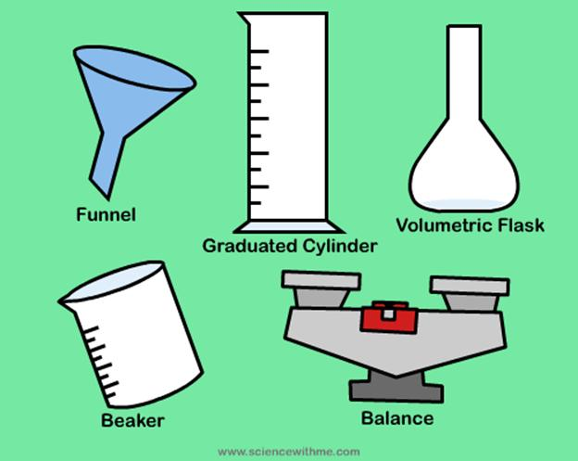
apparatus
Noun. a device or set of equipment used for a specific purpose

Slide 3
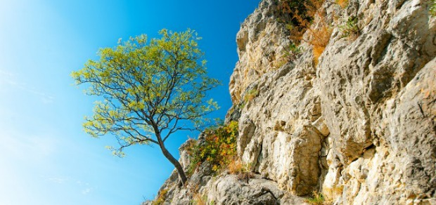
resilient
Adjective. Flexible and springy

Slide 4
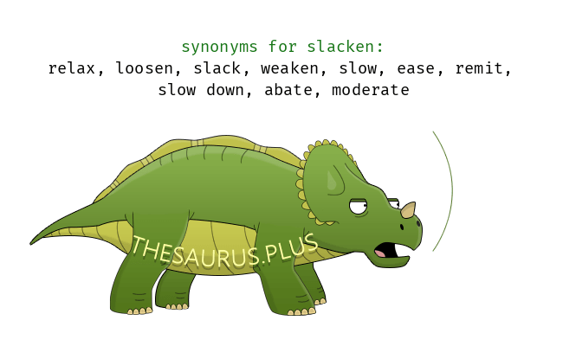
slacken
Verb. to slow down or lessen

Slide 5
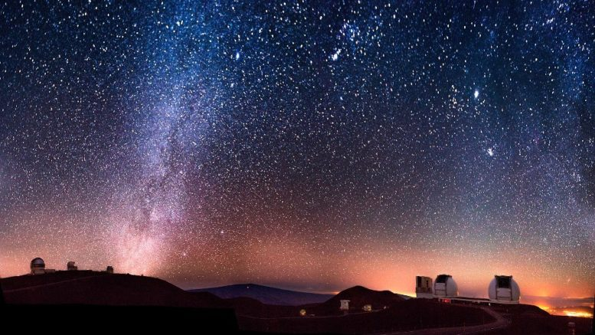
immense
Adjective. Extremely big; huge

Slide 6
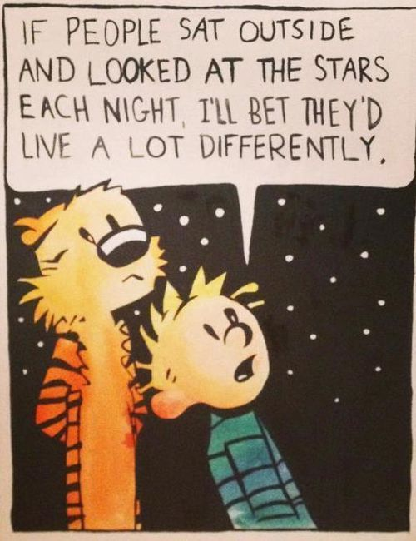
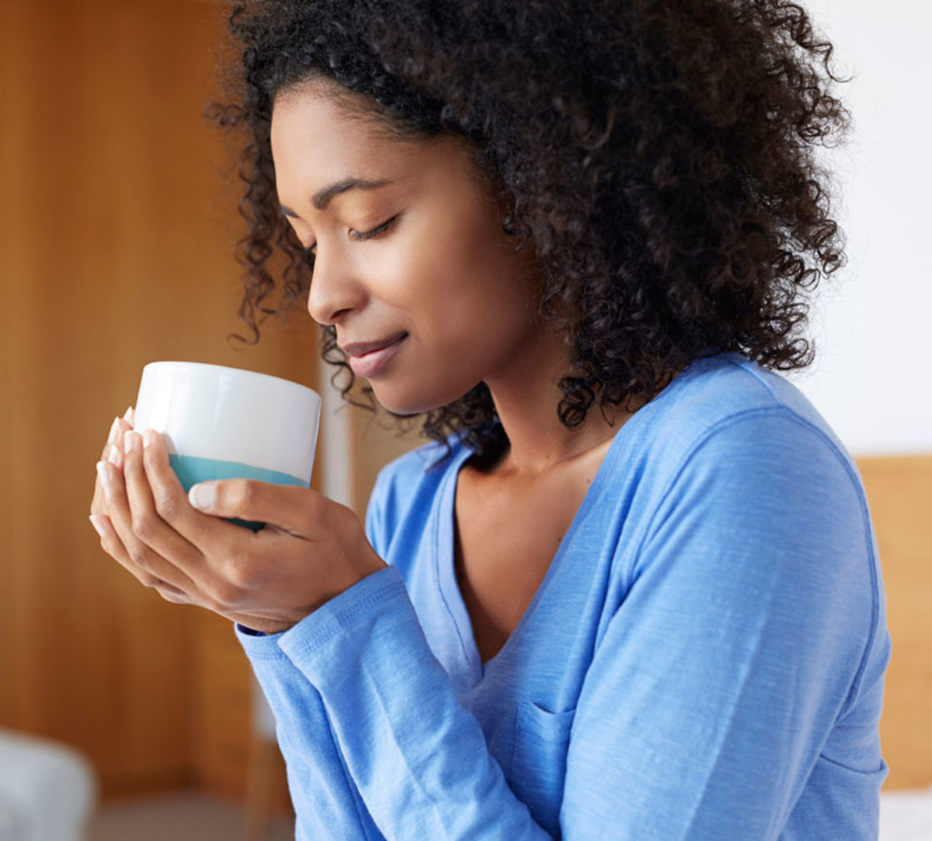
savor
Verb. to take great pleasure in

Slide 7
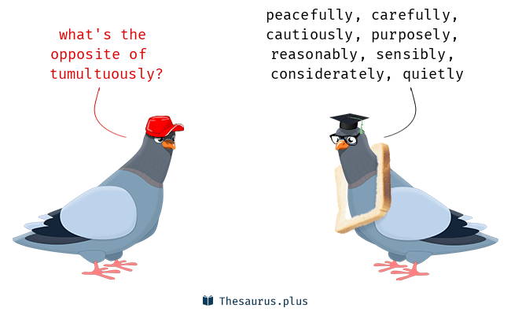
tumultuously
Adverb. In a wild or disorderly way

Slide 8
Greek and Latin Roots
What are roots?
Roots are sometimes from different languages and they help us find the meaning of words.

Slide 9
Greek and Latin Root of the Week
ped
meaning: foot

Slide 10
impediment
noun. Something that stands in one’s way; an obstacle

Slide 11
biped
noun. a creature with two feet

Slide 12
centipede
noun. a creature with 100 feet

